Slide 1

MINI PROJECT ON HINDI LANGUAGE Tasks Performed :- Sentence Tokenization, Word Tokenization, Translation, Understanding Phonetics ,Homophone, Syllabification , POS Tagging
Name : - Harshvardhan Pardeshi
MTech Data Science
Enrolment Number : - 22/10/MI/002
Subject : - (CS 760) Natural Language Processing
JAWAHARLAL NEHRU UNIVERSITY

Slide 2
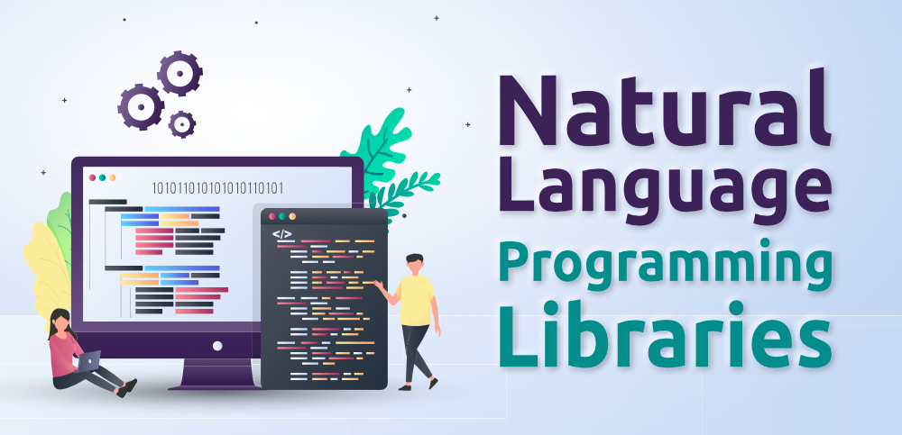
Libraries Used
indicnlp
StanfordNLP
NLTK(Not Preferred)

Slide 3

Why indicnlp is better than NLTK for Indian languages?
indicnlp
NLTK
indicnlp provides built-in support and specific functionality tailored for Indian languages.
indicnlp has extensive Unicode support, which is crucial for handling Indian language text.
indicnlp provides pre-trained models, language resources, and corpora specifically focused on Indian languages.
indicnlp is developed and maintained by a community that is specifically focused on Indian languages.
NLTK, on the other hand, offers more general features that may not be optimized for Indian languages.
NLTK also has Unicode support, but it may not have the same level of specificity for Indian languages.
NLTK offers a wide range of resources for various languages, it may have limited or less comprehensive resources for Indian languages.
NLTK, being a more general-purpose library, may have a broader community but may not have the same level of specialization for Indian languages.

Slide 4
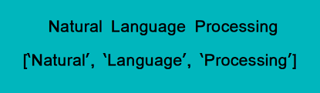

Tokenization
Tokenization is nothing but splitting the raw text into small chunks of words or sentences, called tokens.
If the text is split into words, then its called as 'Word Tokenization’.
If it's split into sentences then its called as 'Sentence Tokenization'.
Word Tokenization
Sentence Tokenization

Slide 5
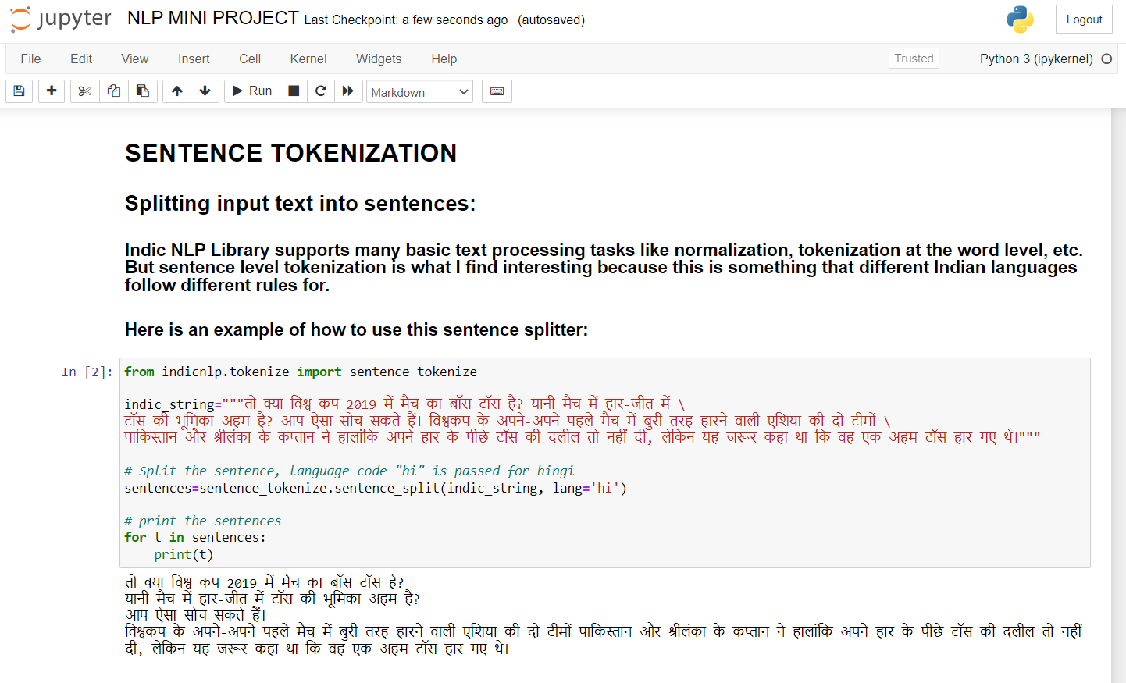

Slide 6
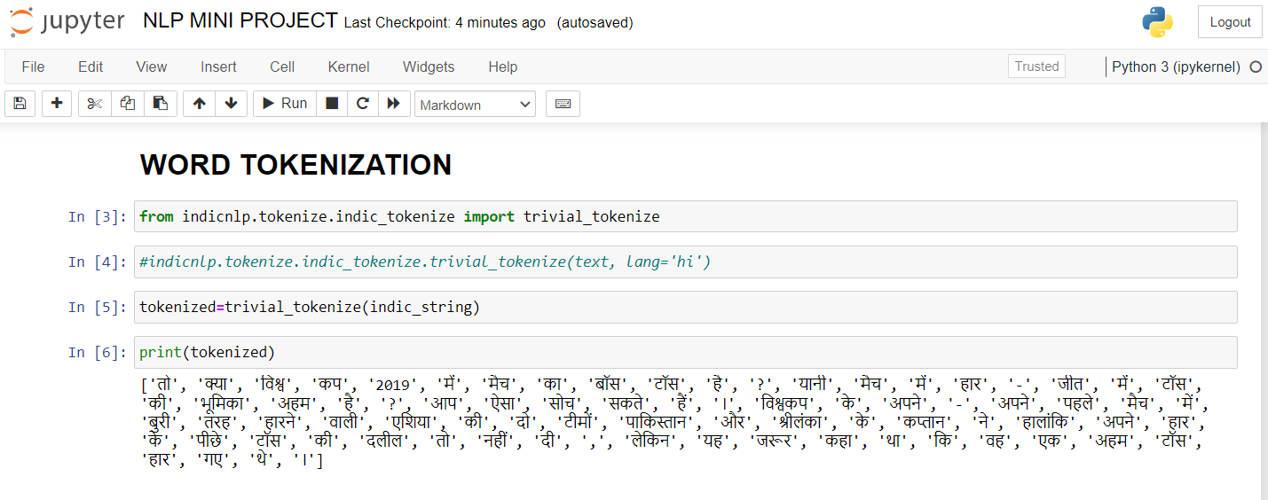

Slide 7
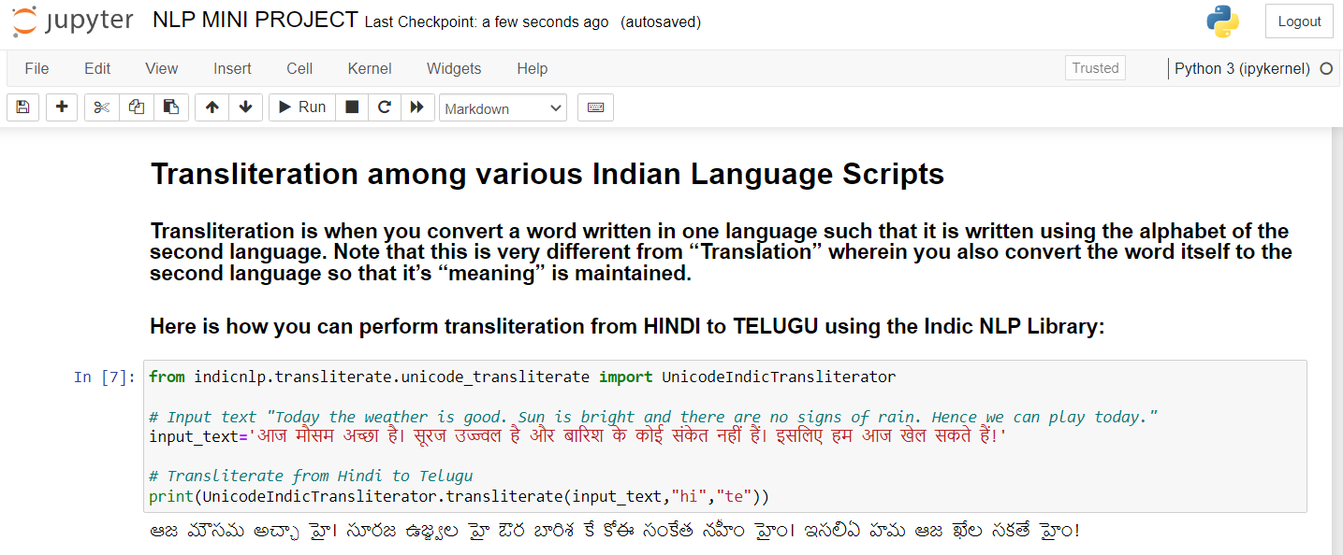

Slide 8
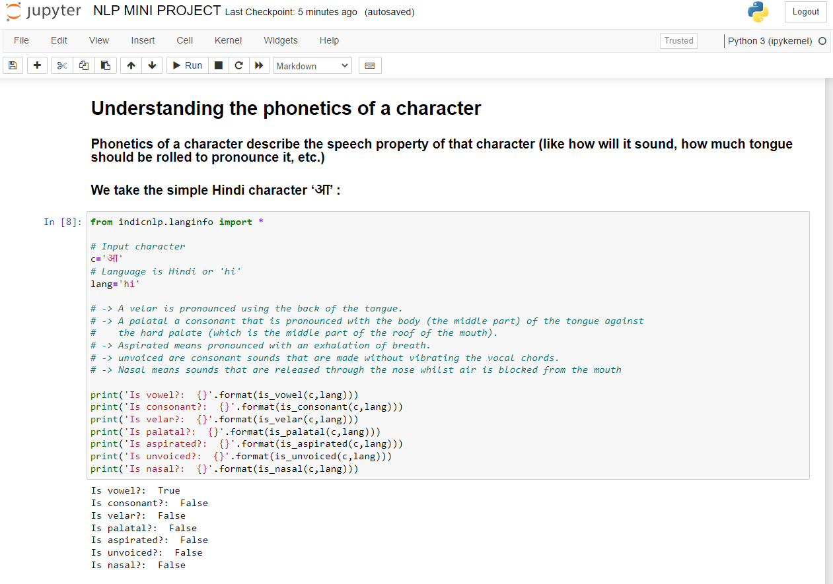

Slide 9
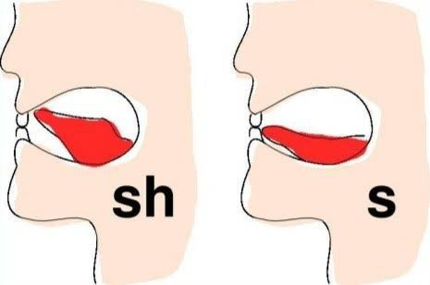
Importance of Phonetics
Phonetics plays a significant role in natural language processing (NLP) by providing insights into the acoustic and perceptual properties of speech sounds. Here are some key reasons why phonetics is important in NLP:
1. Speech Recognition
2. Speech Synthesis
3. Accent and Dialect Variation
4. Pronunciation Modeling
5. Error Detection and Correction
6. Language Acquisition and Learning
7. Phoneme-level Analysis
Phonetics is crucial in NLP for tasks related to speech processing, accent and dialect modeling, pronunciation analysis, error detection and correction, language learning, and more. Understanding the phonetic aspects of language allows NLP systems to handle spoken language effectively and improve the overall performance of speech-related applications.

Slide 10
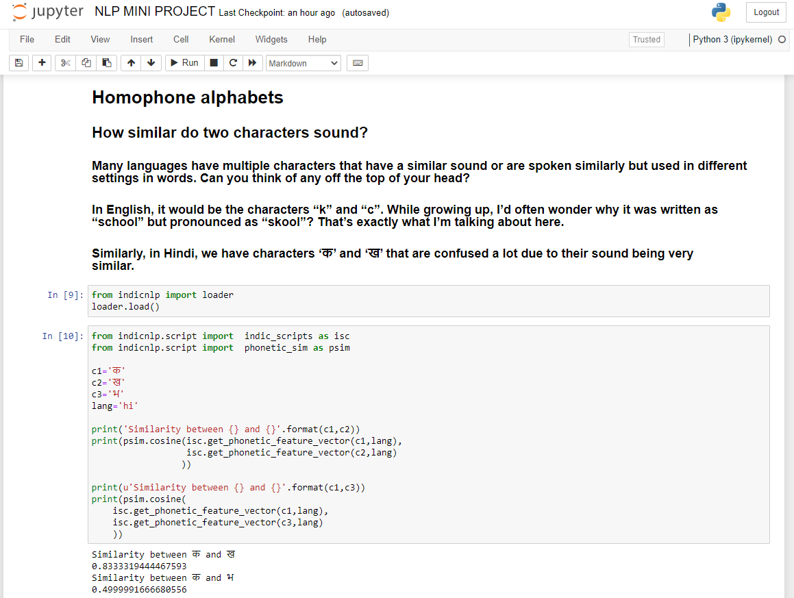

Slide 11
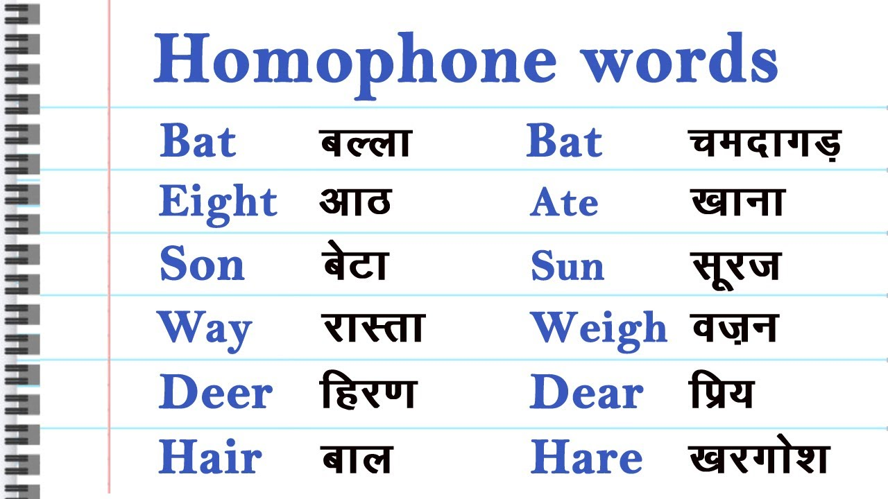
Importance of Homophones
Homophones are words that have the same pronunciation but different meanings and often different spellings. They are important in natural language processing (NLP) for several reasons:
1. Word Sense Disambiguation
2. Speech Recognition
3. Spelling Correction
4. Natural Language Understanding
5. Machine Translation
6. Language Generation
Homophones present challenges in various NLP tasks, including word sense disambiguation, speech recognition, spelling correction, natural language understanding, machine translation, and language generation. Effectively handling homophones enhances the accuracy and fluency of NLP systems, enabling better language processing and comprehension.

Slide 12
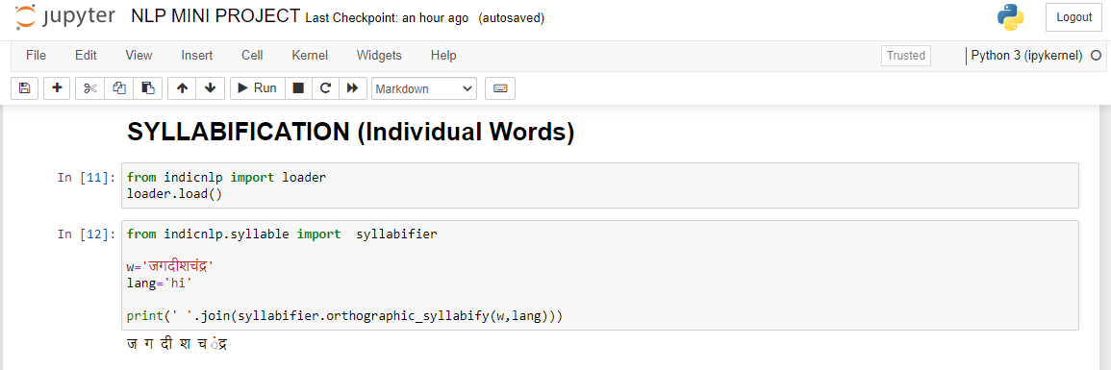
A syllable is a unit of pronunciation that typically consists of a vowel sound (or a vowel sound in combination with one or more consonant sounds). Syllables are important in phonetics and phonology because they help determine the rhythm and structure of a word or phrase.

Slide 13
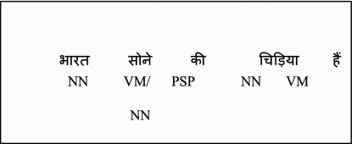
POS Tagging
Part-of-speech (POS) tagging, also known as grammatical tagging or word category disambiguation, is a fundamental task in natural language processing (NLP). It involves assigning grammatical tags or labels to each word in a given text, indicating its part of speech and sometimes additional linguistic information.
The part of speech refers to the syntactic category of a word, such as noun, verb, adjective, adverb, pronoun, preposition, conjunction, or interjection.
POS tagging is crucial for many downstream NLP tasks, including syntactic parsing, information extraction, machine translation, and sentiment analysis.
A COMBINATION OF INDICNLP AND STANFORDNLP HAS BEEN USED IN THIS PROJECT FOR POS TAGGING.

Slide 14
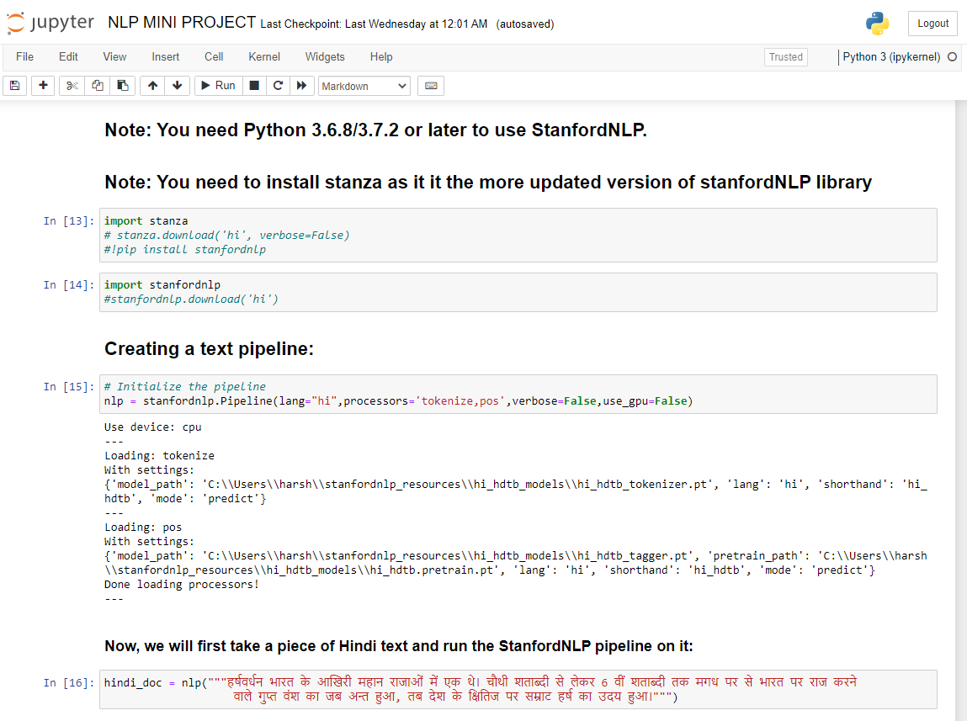

Slide 15
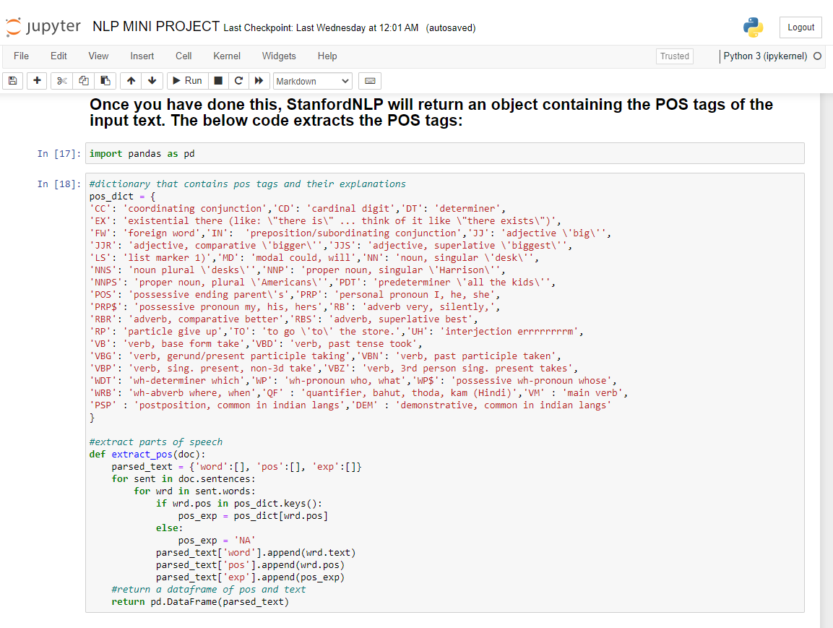

Slide 16
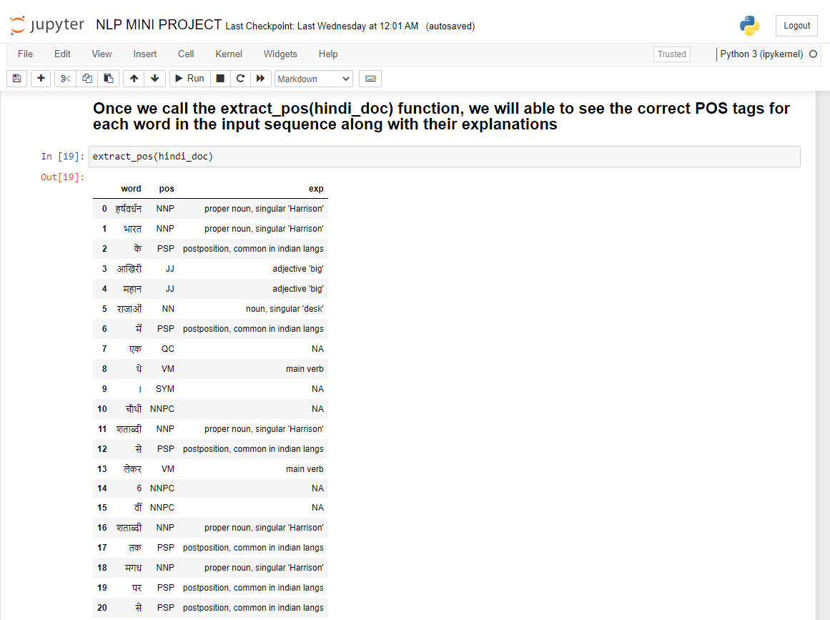

Slide 17
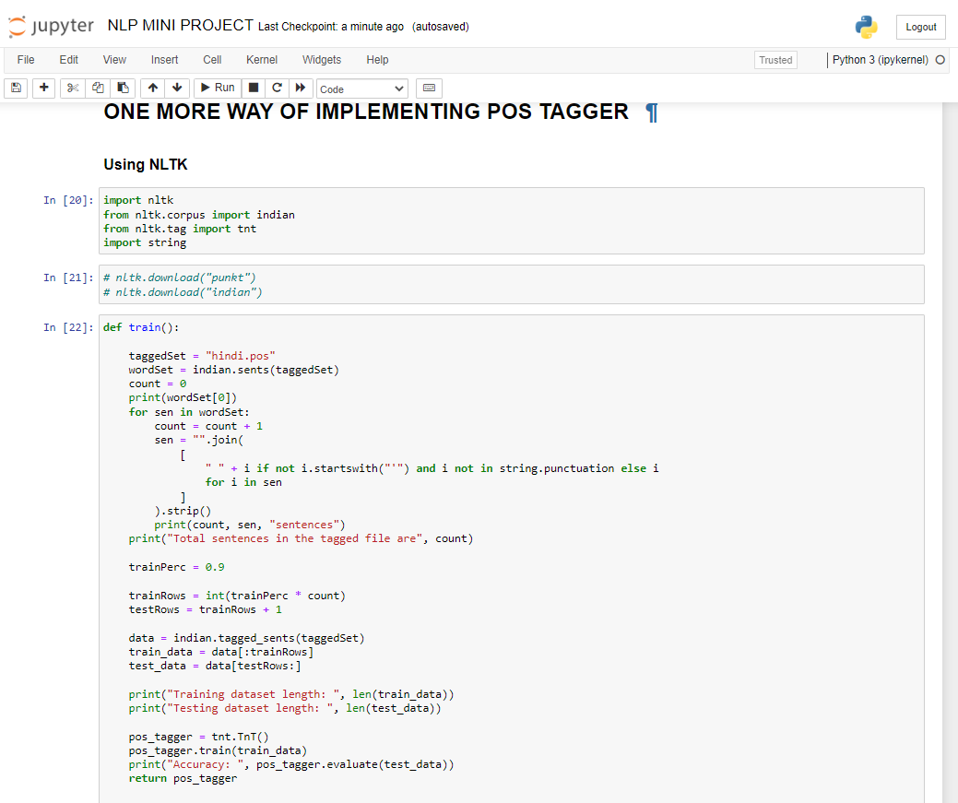

Slide 18
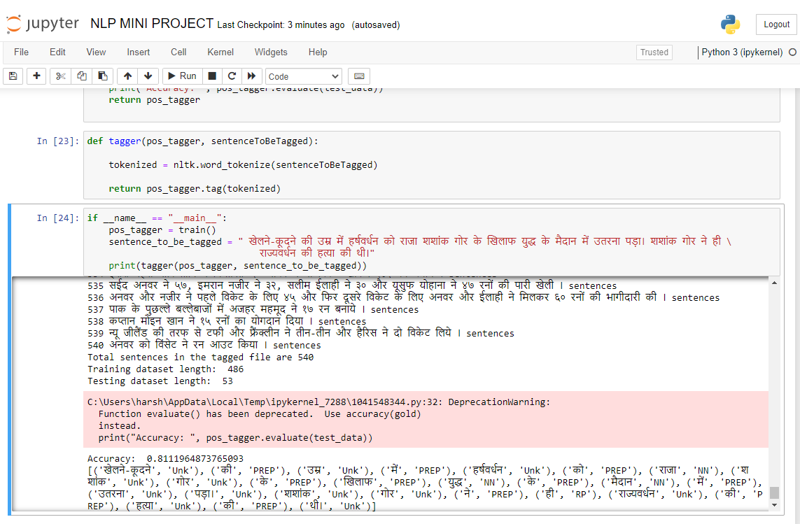

Slide 19
Link to the GITHUB repository

Slide 20
THANK YOU !!

